Slide 1
Team Members: Daniel Francisco, Ryan Lim, Wen Bin Liang, Khanh Nguyen, Aindrila Das Prapti
YAF AI Travel Assistant Chatbot
COSC2408 – Programming Project 1
Team: Team A – 35 Project: AI Travel Assistant

Slide 2
SPRINT 1 PLAYBACK · SLIDE 1 OF 7
Project Overview
Flights, hotels, transfers, accessibility checks — travellers with disabilities have to manage it all across separate platforms, with nothing built to bring it together.
TODAY, A TRAVELER JUGGLES
Flight booking site
WHAT YAF ALREADY HAS
Airline accessibility desk
✓
Passenger app with wheelchair / mobility-equipment profiles
Hotel accessibility reviews
✓
Airline-specific wheelchair & battery verification, QR sharing
Transfer / rental services
✓
An AI Assistant Chatbot, plus internal aviation & accessibility data
↓ ONE ACCESSIBILITY-AWARE ASSISTANT
WHO IT'S FOR
Primary Travelers with disabilities & companions
Secondary Airport, airline & ground-handling staff
YAF AI Travel Assistant Chatbot
Team 35 | A — AI Travel Assistant Chatbot for Your Accessible Flight (YAF)
1

Slide 3
SPRINT 1 PLAYBACK · SLIDE 2 OF 7
Original Plan — Week 1 Commitment
Baseline set in the client proposal and Sprint 1 plan, before this week's work began.
Week 1
Draft initial requirements & low-fidelity wireframes for a candidate Sprint 2 feature
SPRINT 1 BASELINE FEATURE (from the original client proposal)
Staff QR Scan
Staff scan a passenger's QR code to instantly see verified mobility-equipment details and a pass/fail compliance check — built as the counterpart to the existing passenger-facing verification app.
Deliverables committed: initial requirements document, low-fidelity wireframes, (scan results & error states), and a client status update – no formal sign-off required at this stage.
Team 35 | A — AI Travel Assistant Chatbot for Your Accessible Flight (YAF)
2

Slide 4
SPRINT 1 PLAYBACK · SLIDE 2 OF 7
Original Plan — Week 2 Revision
Baseline set in the client proposal and Sprint 1 plan, before this week's work began.
Week 2
Week 3
Refine requirements, build prototypes, secure client sign-off before development
Sprint 1 Playback — present plan quality & forward progress to supervisor
SPRINT 1 BASELINE FEATURE (revised, per the client-confirmed proposal)
AI Travel Assistant Chatbot
Flight-number/destination → route, aircraft & accessibility match → hotel suggestion — replacing the staff-only scan with the feature the client's own travelers will use.
Deliverables committed: revised requirements document, low and high-fidelity prototypes, and full client sign-off before Sprint 2 development begins.
Team 35 | A — AI Travel Assistant Chatbot for Your Accessible Flight (YAF)
2

Slide 5
SPRINT 1 PLAYBACK · SLIDE 3 OF 7
Actual Achievement — Week 1 Evidence
5 / 5
19 hrs
3
Sprint 1 Week 1 tasks completed
Logged this week
Core documents produced
Week 1 built the foundation the pivot was validated against — requirements, wireframes, backend, and research, all shipped on schedule:
✓
Initial requirements doc Staff QR Scan — problem, target users & candidate feature (BA, 4h)
✓
Low-fi wireframes scan, results & error states in Figma (UX, 4h)
✓
Firebase web server & database Auth + Firestore live, confirmed via test sign-up (Dev, 3h)
✓
Wheelchair/aircraft-door research compatibility standards to inform schema (Dev, 4h)
✓
Client status update & agenda team aligned, no follow-up meeting required (PM, 4h)
This foundation is what let us catch the scope pivot early — before Week 2 committed real build time to the wrong feature.
Team 35 | A — AI Travel Assistant Chatbot for Your Accessible Flight (YAF)
3

Slide 6
SPRINT 1 PLAYBACK · SLIDE 3 OF 7
Actual Achievement — Week 2 Evidence
9 / 9
20 hrs
2
Sprint 1 Week 2 tasks completed
Logged this week
External APIs selected & live-tested
We pivoted from Staff QR Scan to the AI Travel Assistant Chatbot after deeper client discussion — then shipped a full sprint's evidence against the new direction:
✓
Revised requirements doc flight/destination → route, aircraft, accessibility match, hotel suggestion
✓
Low-fi + high-fi Figma prototype full conversation flow incl. error & empty states
✓
Flight-data API proof of concept Airlabs — live-tested on real flight VJ82
✓
Hotel/booking provider research StayingAPI selected, live-tested with real accessibility data
✓
Pinecone retrieval research fallback logic to Groq/OpenAI documented
✓
Client review session (4 Sept) requirements formally signed off
Every task closed with a Done / Deliverable / Note-for-next-role handoff — no open follow-ups blocking Sprint 2.
Team 35 | A — AI Travel Assistant Chatbot for Your Accessible Flight (YAF)
3

Slide 7
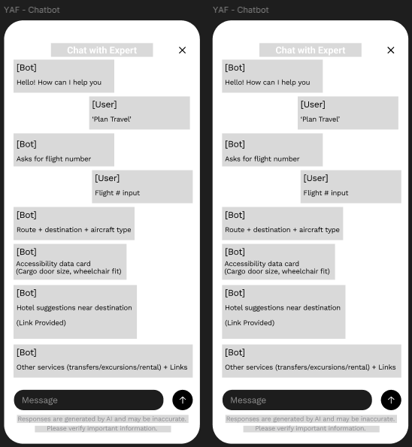
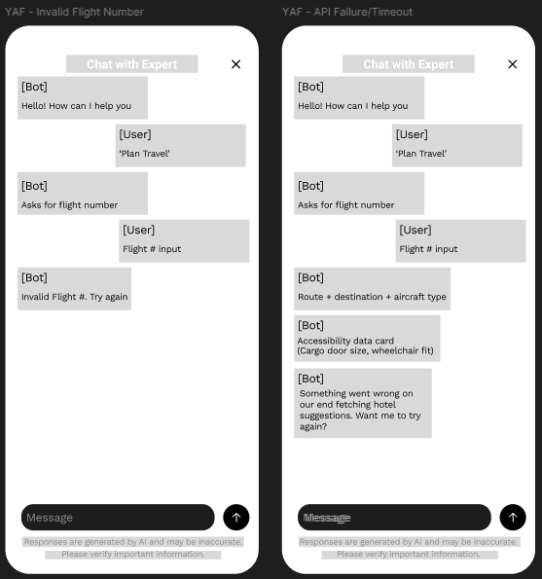
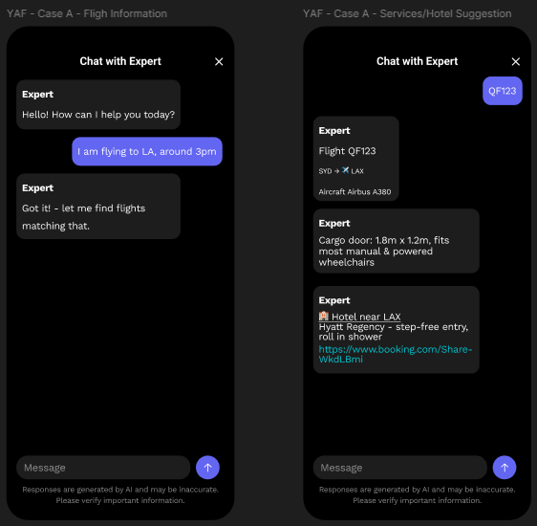
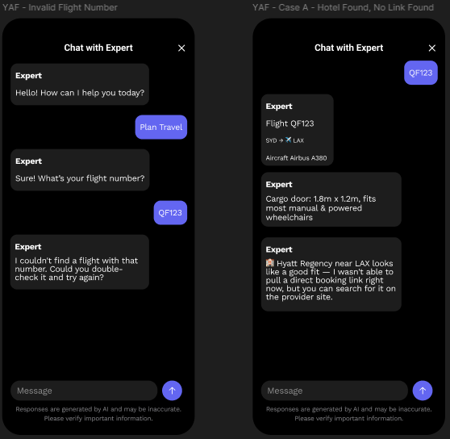
SPRINT 1 PLAYBACK · SLIDE 3 OF 7
Actual Achievement — Week 2 Evidence
9 / 9
20 hrs
2
Sprint 1 Week 2 tasks completed
Logged this week
External APIs selected & live-tested
We pivoted from Staff QR Scan to the AI Travel Assistant Chatbot after deeper client discussion — then shipped a full sprint's evidence against the new direction:
✓
Revised requirements doc flight/destination → route, aircraft, accessibility match, hotel suggestion
✓
Low-fi + high-fi Figma prototype full conversation flow incl. error & empty states
Every task closed with a Done / Deliverable / Note-for-next-role handoff — no open follow-ups blocking Sprint 2.
Team 35 | A — AI Travel Assistant Chatbot for Your Accessible Flight (YAF)
3

Slide 8
SPRINT 1 PLAYBACK · SLIDE 3 OF 7
Actual Achievement — Week 2 Evidence
9 / 9
20 hrs
2
Sprint 1 Week 2 tasks completed
Logged this week
External APIs selected & live-tested
We pivoted from Staff QR Scan to the AI Travel Assistant Chatbot after deeper client discussion — then shipped a full sprint's evidence against the new direction:
✓
Revised requirements doc flight/destination → route, aircraft, accessibility match, hotel suggestion
✓
Low-fi + high-fi Figma prototype full conversation flow incl. error & empty states
✓
Flight-data API proof of concept Airlabs — live-tested on real flight VJ82
✓
Hotel/booking provider research StayingAPI selected, live-tested with real accessibility data
✓
Pinecone retrieval research fallback logic to Groq/OpenAI documented
✓
Client review session (4 Sept) requirements formally signed off
Every task closed with a Done / Deliverable / Note-for-next-role handoff — no open follow-ups blocking Sprint 2.
Team 35 | A — AI Travel Assistant Chatbot for Your Accessible Flight (YAF)
3

Slide 9



SPRINT 1 PLAYBACK · SLIDE 4 OF 7
Why It Matters
For the traveler
For the client
For the project
Compatible aircraft and accessibility-vetted hotels, from one search
Replaces hours of research across separate sites
Replaces a staff-only feature with one their users feel
A single assistant spanning flight, aircraft, and destination accessibility
Upgrades YAF's chatbot from static Q&A
Recommend flights, routes, accessibility and hotels.
Client sign-off secured. On 4 September the client confirmed the pivot and the Sprint 2 integration scope: one flight-data source, one hotel/accessibility system, one excursion example and one transfer example.
✓
Team 35 | A — AI Travel Assistant Chatbot for Your Accessible Flight (YAF)
4

Slide 10
SPRINT 1 PLAYBACK · SLIDE 5 OF 7
Blockers & Open Questions
An honest account of what's unresolved heading into Sprint 2 — and our plan for each.
!
Shared API quota
!
Trip/session data model
Flight-data free tier is 600 units/month, 1 req/sec, shared across the whole team — could constrain live testing close to demos.
Unconfirmed whether an existing YAF trip/session model exists to attach external services to, or whether this project defines one.
Plan: Monitor usage during dev; ration test calls ahead of Sprint 2 demo.
Plan: Flagged to client; confirm before Sprint 2 build starts.
!
Hotel provider narrowing
?
Which AI model for the chatbot?
Of 5 hotel/booking sources compared, only the “booking” platform proved reliable — airbnb, vrbo and google were unreliable or unavailable.
Pinecone supports multiple embedding/generation models — the client hasn't settled on which one to standardize on for retrieval and response quality.
Plan: Proceed with booking-only source for Sprint 2; revisit if coverage gaps appear.
Plan: Trial the top 2 candidates against sample queries; confirm choice with client before Sprint 2 build.
Team 35 | A — AI Travel Assistant Chatbot for Your Accessible Flight (YAF)
5

Slide 11
SPRINT 1 PLAYBACK · SLIDE 6 OF 7
Task Allocation & Time Spent — Week 1
Matches logged Planner records for Sprint 1 Week 1 — 5 tasks, one per member, each closed with a Done / Deliverable handoff.
Member | Role | Tasks this week | Hours
Daniel Francisco | PM | Client status update & follow-up agenda after second client call | 4h
Wen Bin Liang | BA | Drafted initial requirements for the Staff QR Scan flow | 4h
Ryan Lim | UX | Wireframed the QR scan flow (scan, results & error states) | 4h
Khanh Nguyen | Dev | Stood up the Firebase web server & database | 3h
Aindrila Das Prapti | Dev | Researched wheelchair/aircraft-door compatibility standards | 4h
Total: 19 hours across 5 members • 5/5 tasks Done • one task per member
Team 35 | A — AI Travel Assistant Chatbot for Your Accessible Flight (YAF)
6

Slide 12
SPRINT 1 PLAYBACK · SLIDE 6 OF 7
Task Allocation & Time Spent — Week 2
Matches logged Planner records for Sprint 1 Week 2 — 9 tasks, every role cleared its hours on a completed task.
Member | Role | Tasks this week | Hours
Daniel Francisco | PM | Revised requirements doc; coordinated client review session | 4h
Wen Bin Liang | BA | Flight-data & hotel provider research; acceptance criteria doc | 4h
Ryan Lim | UX | Low-fidelity wireframes; high-fidelity Figma prototype | 4h
Khanh Nguyen | Dev | Tech-stack & schema review; flight-data API proof of concept | 4h
Aindrila Das Prapti | Dev | Pinecone retrieval & fallback-logic research | 4h
Total: 20 hours logged across 5 members • 9/9 tasks Done • workload evenly distributed at 4h each
Team 35 | A — AI Travel Assistant Chatbot for Your Accessible Flight (YAF)
6

Slide 13
SPRINT 1 PLAYBACK · SLIDE 6 OF 7
Task Allocation & Time Spent — Week 3
Matches the current Planner board iSprint 1 Week 3 — 5 tasks assigned for Week 3, one per member, budgeted at 4h each.
Member | Role | Planned task | Hours
Daniel Francisco | PM | Finalise Sprint 1 deliverables & run Sprint 1 playback | 4h
Wen Bin Liang | BA | Stress-test data schema against edge cases | 4h
Ryan Lim | UX | Finalise prototype based on client feedback | 4h
Khanh Nguyen | Dev | Finalise infrastructure for Sprint 2 | 4h
Aindrila Das Prapti | Dev | Hotel/booking API integration proof of concept | 4h
Total: 20 hours budgeted across 5 members • In-progress
Team 35 | A — AI Travel Assistant Chatbot for Your Accessible Flight (YAF)
6

Slide 14
SPRINT 1 PLAYBACK · SLIDE 7 OF 7
Timeline & Next Steps
THIS SPRINT
PROMISED — SPRINT 2
1
Week 1
Kick-off with client; initial requirements drafted for Staff QR Scan
1
Build the flight-lookup → aircraft-compatibility → hotel-suggestion flow end-to-end
4 Sept
2
Integrate Pinecone retrieval with Groq/OpenAI fallback (>10s or no answer)
2
Client review session — pivot to AI Travel Assistant Chatbot confirmed & signed off
3
QA the build against the 18-point acceptance criteria document
3
Week 2
Flight-data & hotel APIs selected and proof-of-concept
Resolve open items: trip/session data model, hotel provider confirmation
4
Sprint 1 close: Requirements signed off, prototype validated, Sprint 2 scope confirmed with the client.
Team 35 | A — AI Travel Assistant Chatbot for Your Accessible Flight (YAF)
7

